Slide 1

Insect Classification
Guide - Professor Ozgur Ozturk
Team Members:
Dishnat Fapot
Krishna Sai Biradar
Akhil Kumar Kondamidi

Slide 2
Introduction
Agriculture, which is considered the backbone of the economy, contributes to the country’s economic growth and determines the standard of life.
Insect pests are known to be a major cause of damage to commercially important agricultural crops. Categorization of insect pests plays a crucial role in agricultural pest forecasting, which is vital for food security.
This study aims to classify and detect the insects in rice, wheat, etc. using different Approaches and insect pest detection algorithms.

Slide 3
Research Question
Does the Hybrid (Resnet50 and VGG16) model approach help in the classification of Hierarchical Classes?
What is the best method of data augmentation for improving the overall accuracy?
Which of the Approach (Noise, Gaussian, Cascade) fits best to gain a higher Accuracy in our Model?

Slide 4
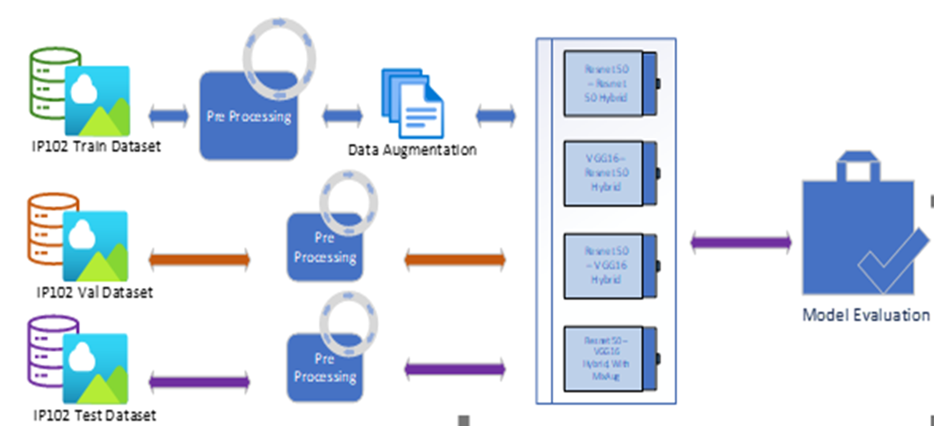
Research Methodology
Data Pre-processing
Resize
Crop
Normalized
Data Augmentation
Transfer Learning
Fine Tuning
Using Deep Features
Cascade Transfer Learning
Hyperparameters

Slide 5
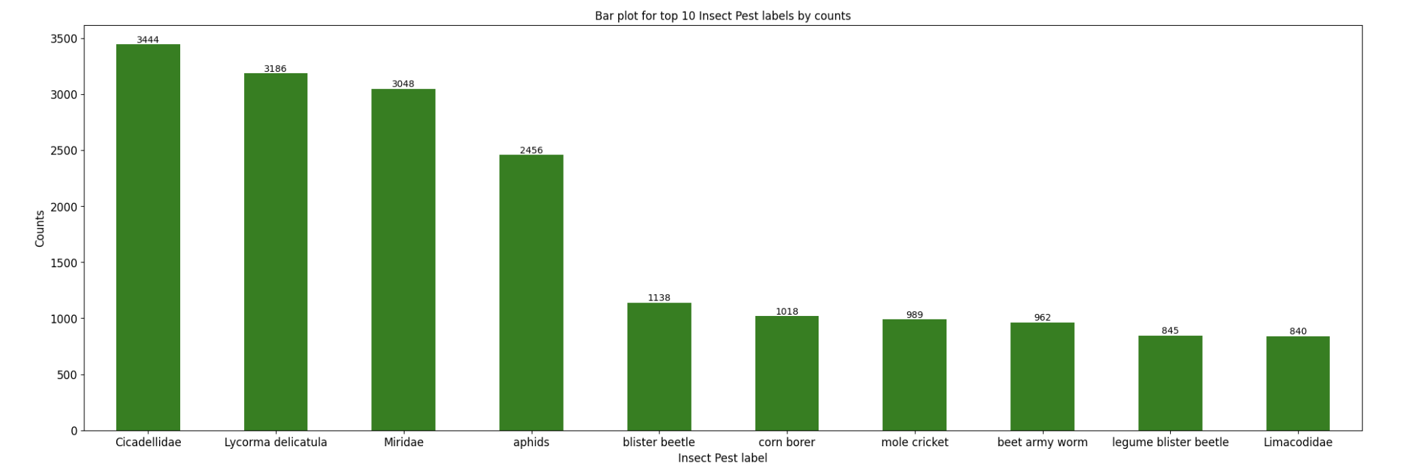
Top 10 Labels by counts
Cicadellidae stands on top of the list with highest number of datapoints in the train dataset while Limacodidae stands at 10th position.

Slide 6
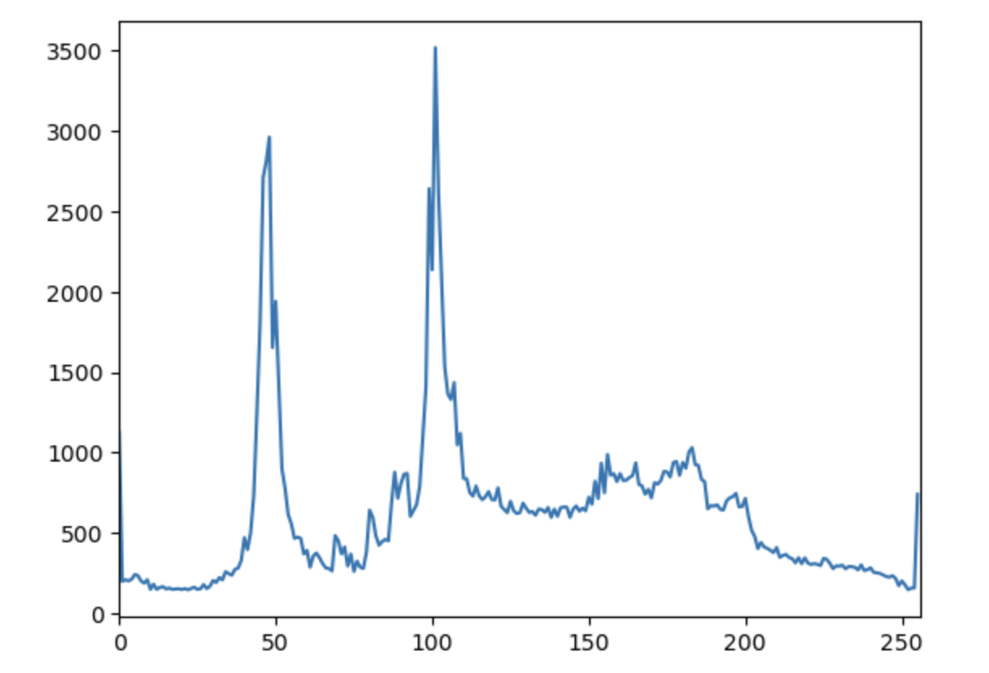
Pixel Distribution
Pixel distribution refers to the distribution of pixel values across all images in the dataset.
A pixel with green, red , and blue values all between 150 and 200 would represent a medium-bright color with no dominant hue.
pixel distribution

Slide 7
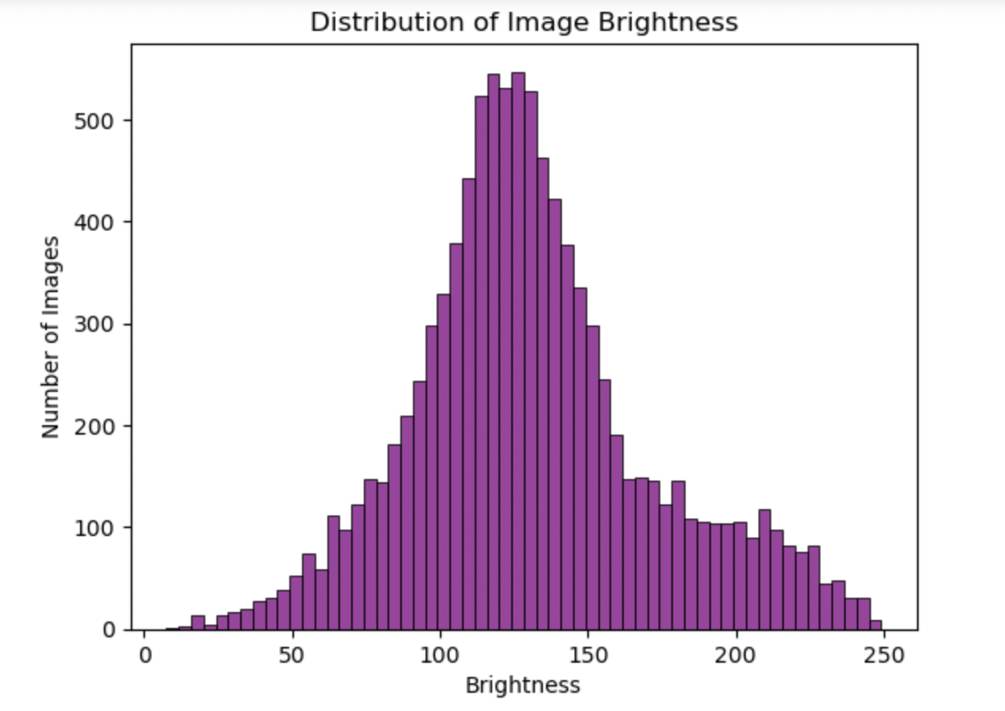
Histogram of Image Brightness Values
If the histogram shows a normal distribution, it indicates that the majority of images have an average brightness level, and the dataset is balanced.

Slide 8
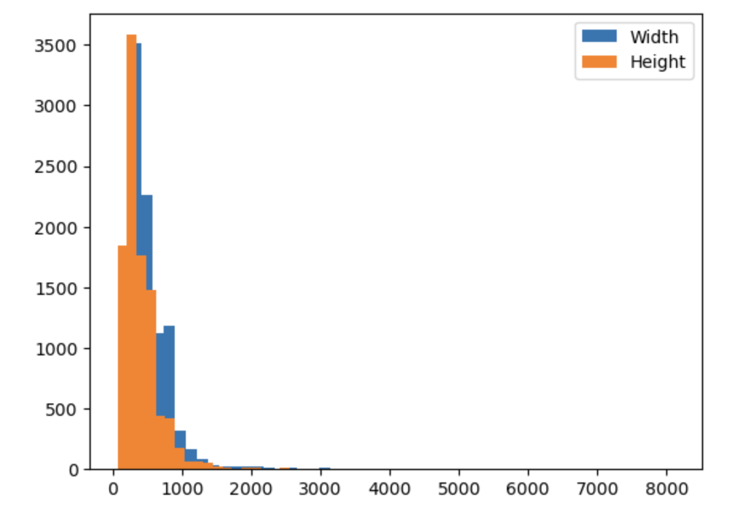
Image size Distribution
This plot provide the image size distribution in the dataset.
It can help to identify outliers i.e., presence of extreme large or extreme small images.
Image Size Distribution

Slide 9
Model
The ResNet50 was trained on the ImageNet dataset, achieving state-of-the-art performance on several image classification benchmarks. The ResNet architecture has been used in computer vision tasks, including image classification, object detection etc. Its architecture has also been adapted for other computer vision tasks, such as object detection. ResNet50 has become a popular choice for transfer learning, where the pre-trained weights on ImageNet can be fine-tuned on a new dataset for a specific image classification task.​
VGG16 has achieved state-of-the-art performance on several image classification benchmarks, including the ImageNet Large Scale Visual Recognition Challenge (ILSVRC) in 2014, where it achieved a top-5 error rate of 7.3%. Its simplicity and uniformity have also made it a popular choice for transfer learning, where the pre-trained weights on ImageNet can be fine-tuned on a new dataset for a specific image classification task.

Slide 10
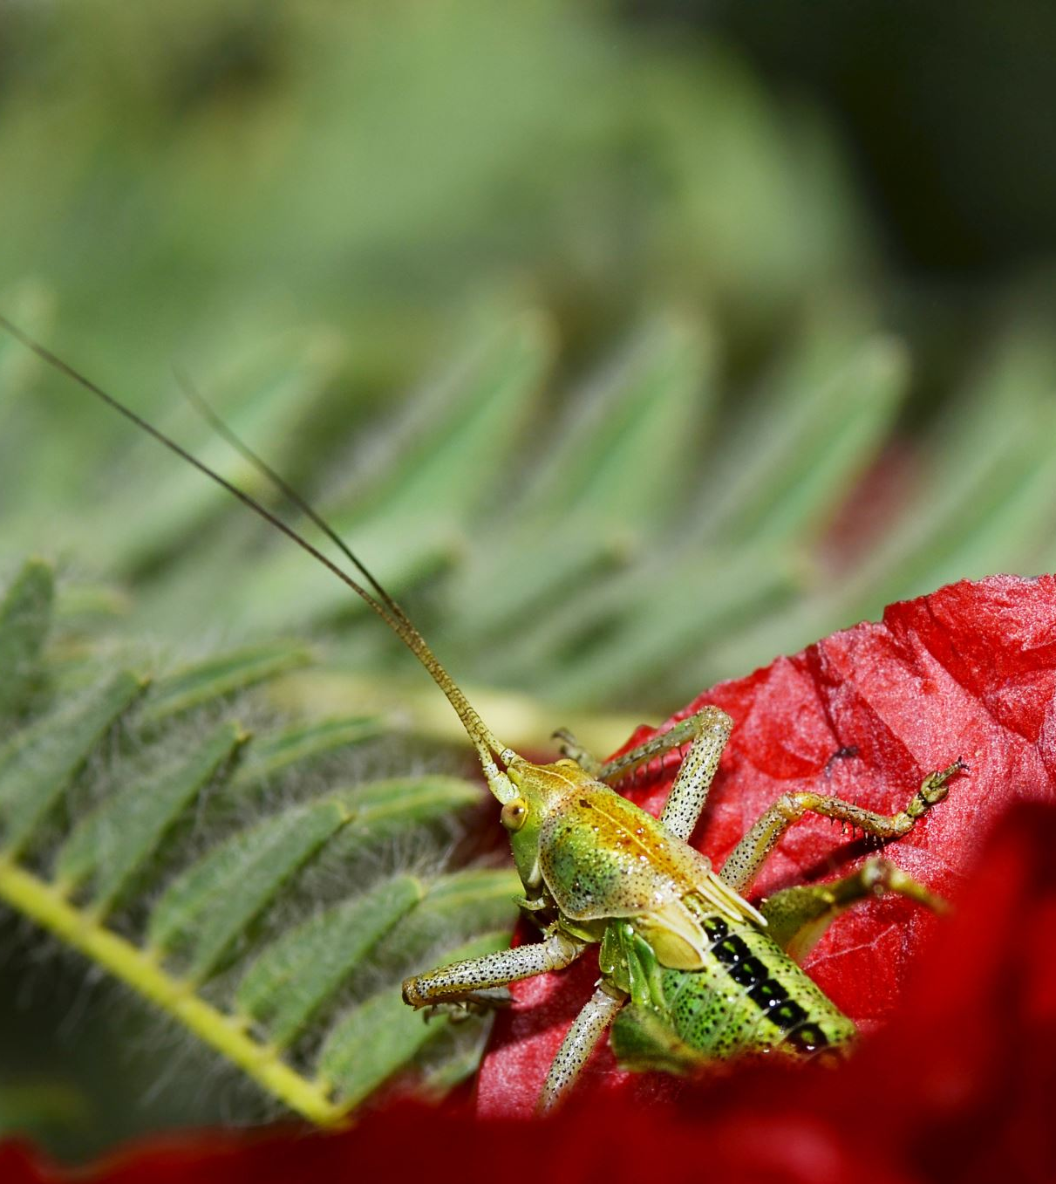
Approach
Noise refers to any unwanted variation or distortion in the image signal that can reduce its quality or make it difficult to interpret. Noise can have a variety of negative effects on image analysis tasks, such as reducing accuracy, introducing errors, and making it difficult to extract meaningful information from the image. Techniques such as noise reduction, filtering, and image enhancement can be used to mitigate the effects of noise and improve image quality.
Cascade would use a separate classifier to recognize different features of the image that are relevant for the current level of categorization. The outputs of each stage would be combined to generate the final classification result.
The Gaussian noise can have a significant impact on image quality, making it harder to discern fine details and reducing the accuracy of image classification algorithms. Gaussian smoothing can also help to reduce the impact of other types of noise or image creation that may be present in the image, such as motion blur or camera shake. By improving the quality of the input image, the accuracy of the classification algorithm can be improved as well.

Slide 11
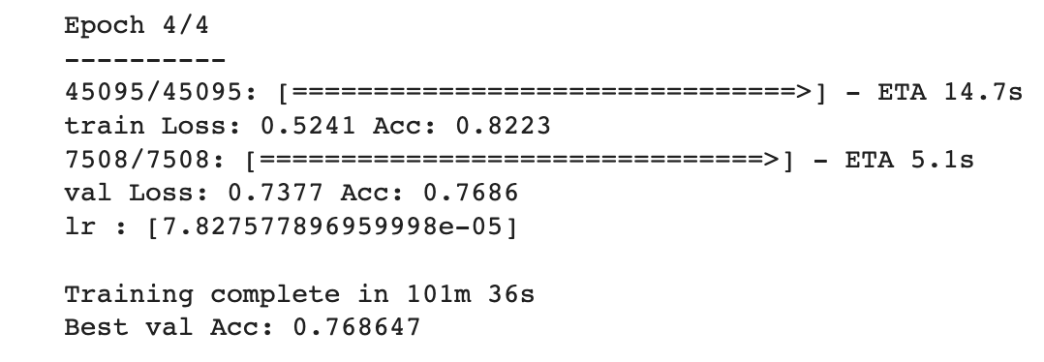
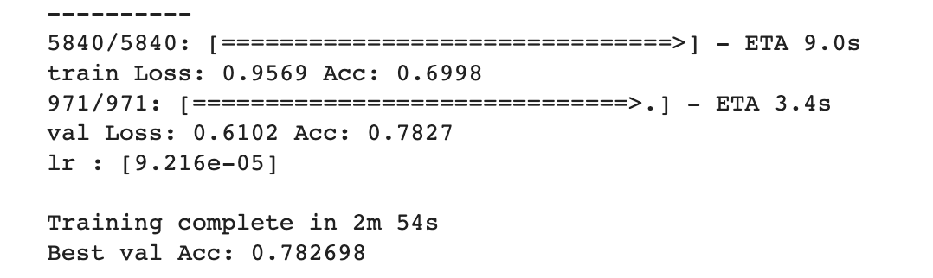
Approach 1:- Pretrained Resnet and VGG16
Pretrained ResNet50
Pretrained VGG16

Slide 12
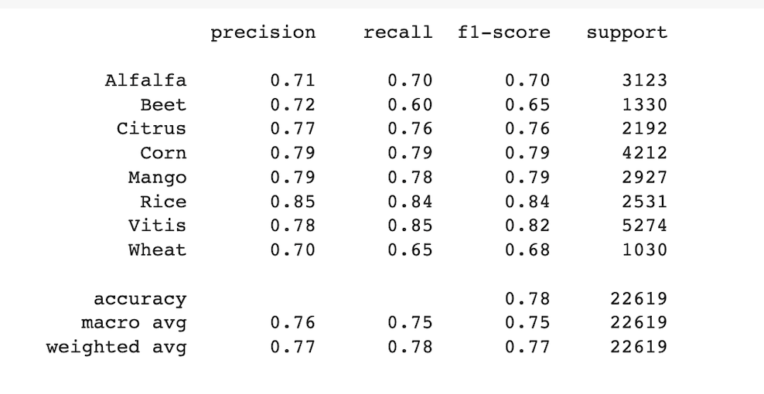
Approach 2:- Both Resnet 50

Slide 13
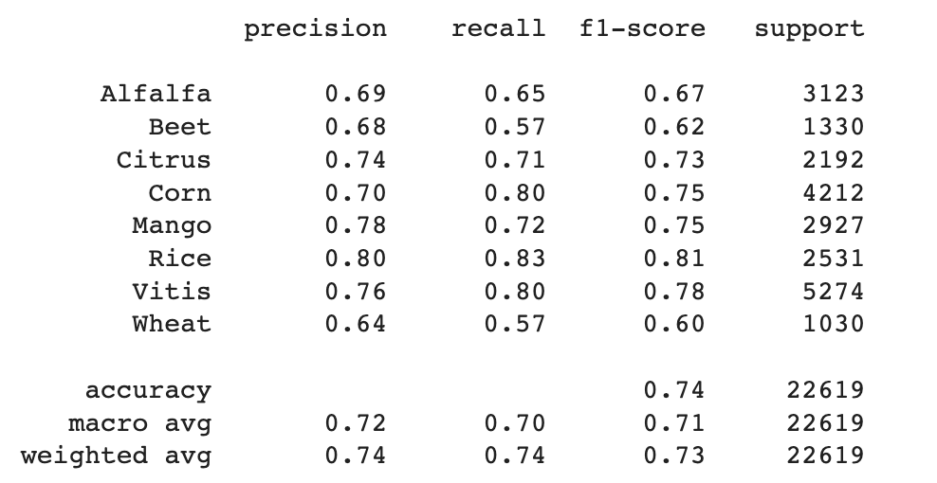
Approach 3:-Both VGG16

Slide 14
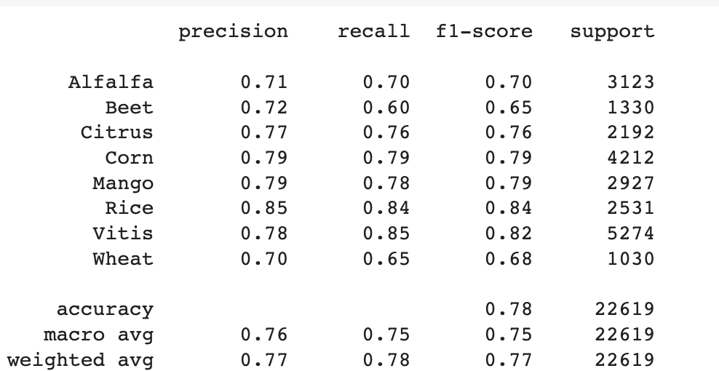
Approach 4:- Level 1 Resnet50 – Level 2 VGG16
Does the Hybrid (Resnet50 and VGG16) model approach help in the classification of Hierarchical Classes? The model's performance was hardly affected as the accuracy remained nearly unchanged. However, if the model was trained for more epochs, a noticeable improvement in accuracy could be observed.

Slide 15
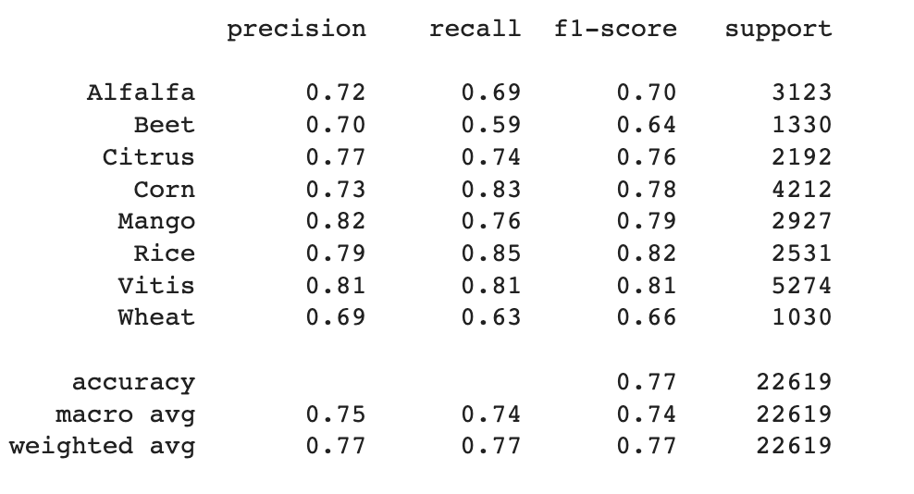
Approach 5:-Both Resnet 50 With Cascade Training
Similar to the previous one, here all the resnet50 used in both level we had the same result as the previous one.

Slide 16
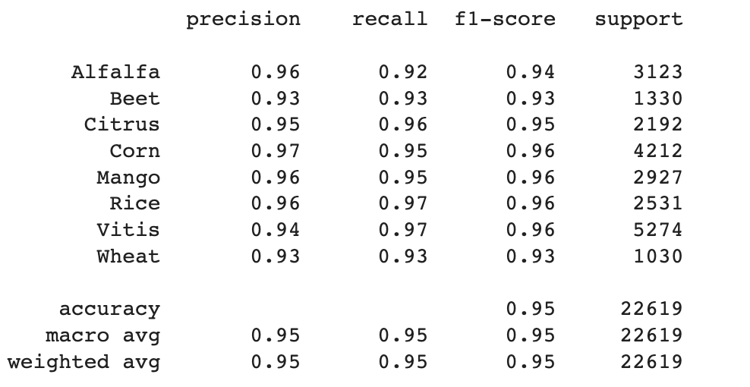
Approach 6:-Level 1 VGG16 – Level 2 Resnet 50 with Augmax_noise
What is the best method of data augmentation for improving the overall accuracy? -
Here the Resnet50-VGG16 hybrid model is trained by utilizing the AugMix for data augmentaion and adding the random noise in the training image to increase the features from the image as well as increase the robutess of the model and showed consistently low errors on the prediction. And the same approach had been used in this work with the addition of noise in the training.

Slide 17
Future Scope
The utilization of insect classification algorithms enables the gathering of data regarding insect populations, distribution, and behavior, which in turn can be utilized to guide and enhance conservation efforts, pest control measures, and scientific research.
By combining insect classification algorithms with other technologies like drones, sensors, and autonomous vehicles, it would be possible to collect more extensive data on insects in their natural habitats. This would result in improved data analysis and a deeper comprehension of insect ecology and behavior.
A comprehensive investigation into the impact of pests on crops and the resulting economic losses in various countries has generated sufficient data to facilitate the implementation of AI and ML-based approaches.

Slide 18
Conclusion
The Hybrid Approach of VGG16 and ResNet50, has an average accuracy of close to 75%.
Whereas with ResNet50 and VGG16 approaches, 76% of average accuracy and the macro average of 77.76%, and a weighted average of 78% are observed.
Also different Approaches used were Noise and Cascade. Where Cascade Accuracy was Comparatively low.
The final best model with gained higher Accuracy is ResNet50 and VGG16 Hybrid model which is trained with Noise in the image and the AugMix method.

Slide 19
References
https://github.com/xpwu95/IP102
Li, Yanfen & Wang, Hanxiang & Dang, L. Minh & Sadeghi-Niaraki, Abolghasem & Moon, Hyeonjoon. (2020). Crop pest recognition in natural scenes using convolutional neural networks. Computers and Electronics in Agriculture. 169. 10.1016/j.compag.2019.105174.
Nanni, Loris & Manfè, Alessandro & Maguolo, Gianluca & Lumini, Alessandra & Brahnam, Sheryl. (2021). High performing ensemble of convolutional neural networks for insect pest image detection. Ecological Informatics. 67. 101515. 10.1016/j.ecoinf.2021.101515.
W. Dawei, D. Limiao, N. Jiangong, G. Ji-yue, Z. Hongfei, and H. Zhongzhi, "Recognition pest by image-based transfer learning," Journal of the science of food and agriculture, vol. 99, no. 10, pp. 4524-4531, 2019.

Slide 20
THANK YOU

